Slide 1
Progress on wave physics in 1D waveguide cavity and cross cavity
Yutong Zhao
Oct 15th 2018

Slide 2
Target: Understanding level attraction
Method:
Maxwell equation + cavity perturbation
Experiment
Simulation from CST software
Scenario:
1D waveguide cavity
Planar cross cavity

Slide 3
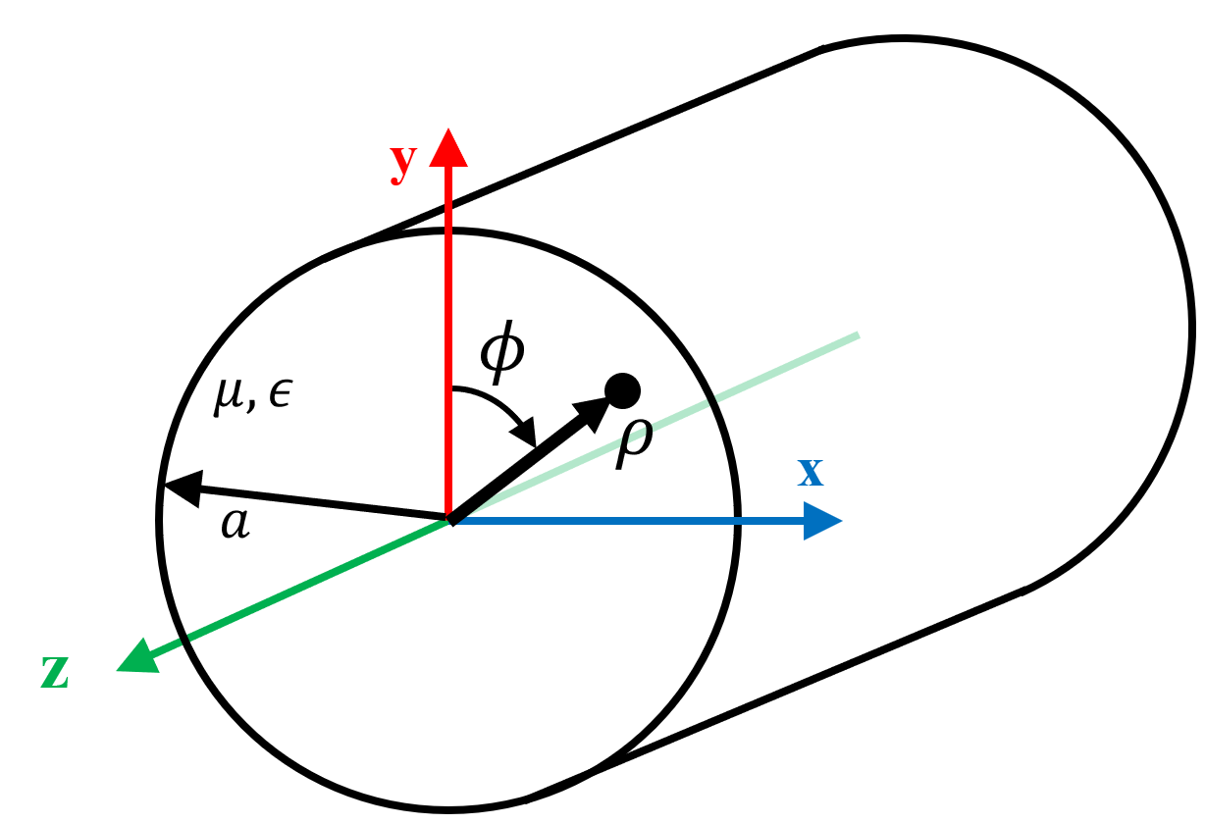
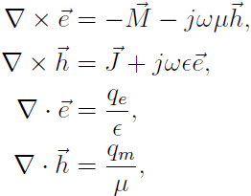
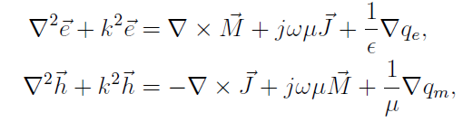

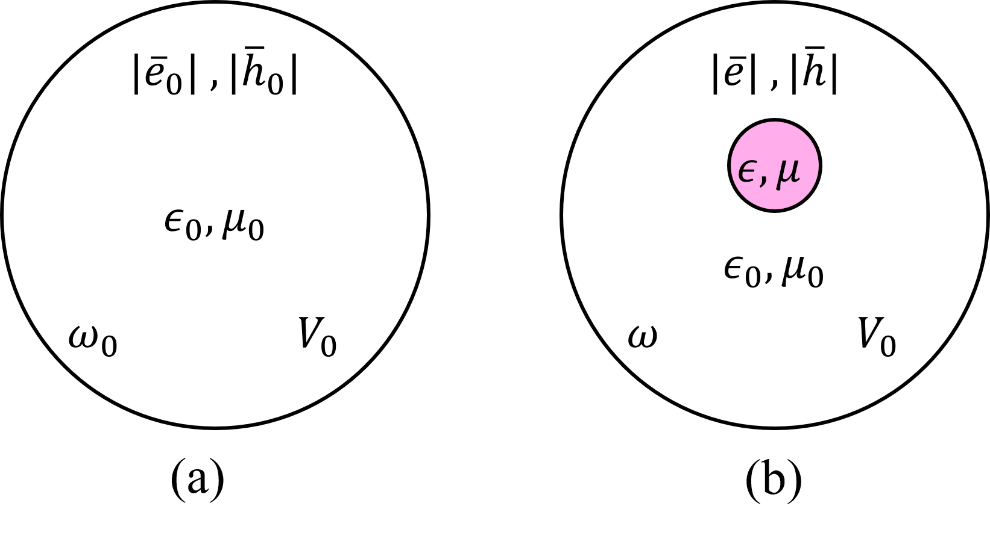


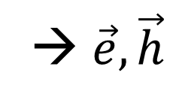
Maxwell equations
Vector wave equation
→ $\vec{e},\vec{h}$
We assume
In a source free region
Cavity perturbation theory

Slide 4
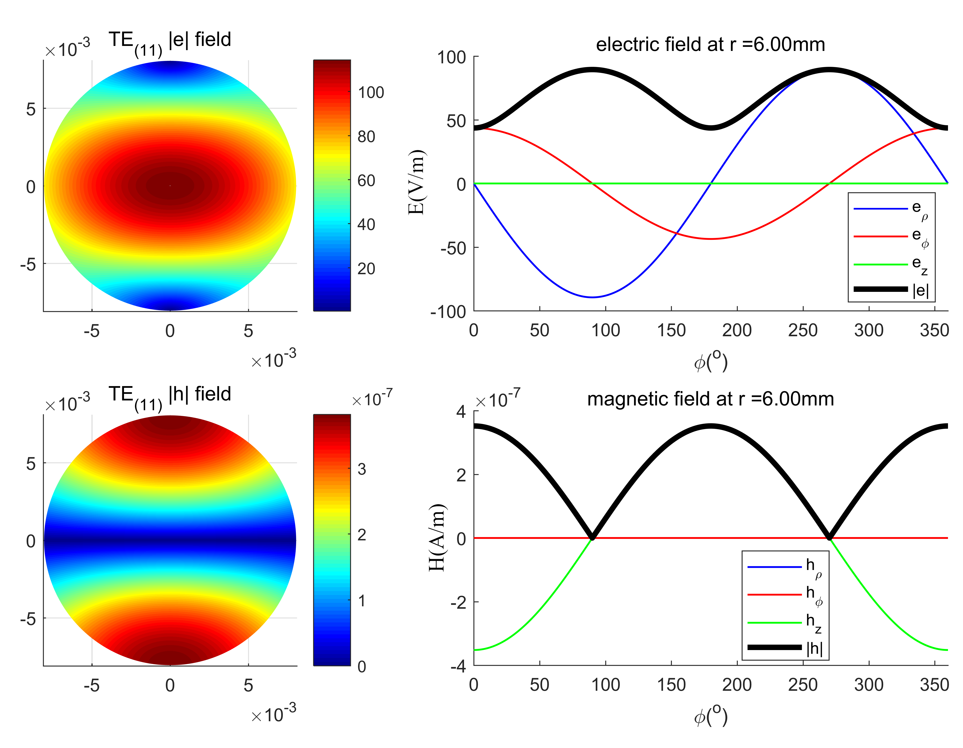
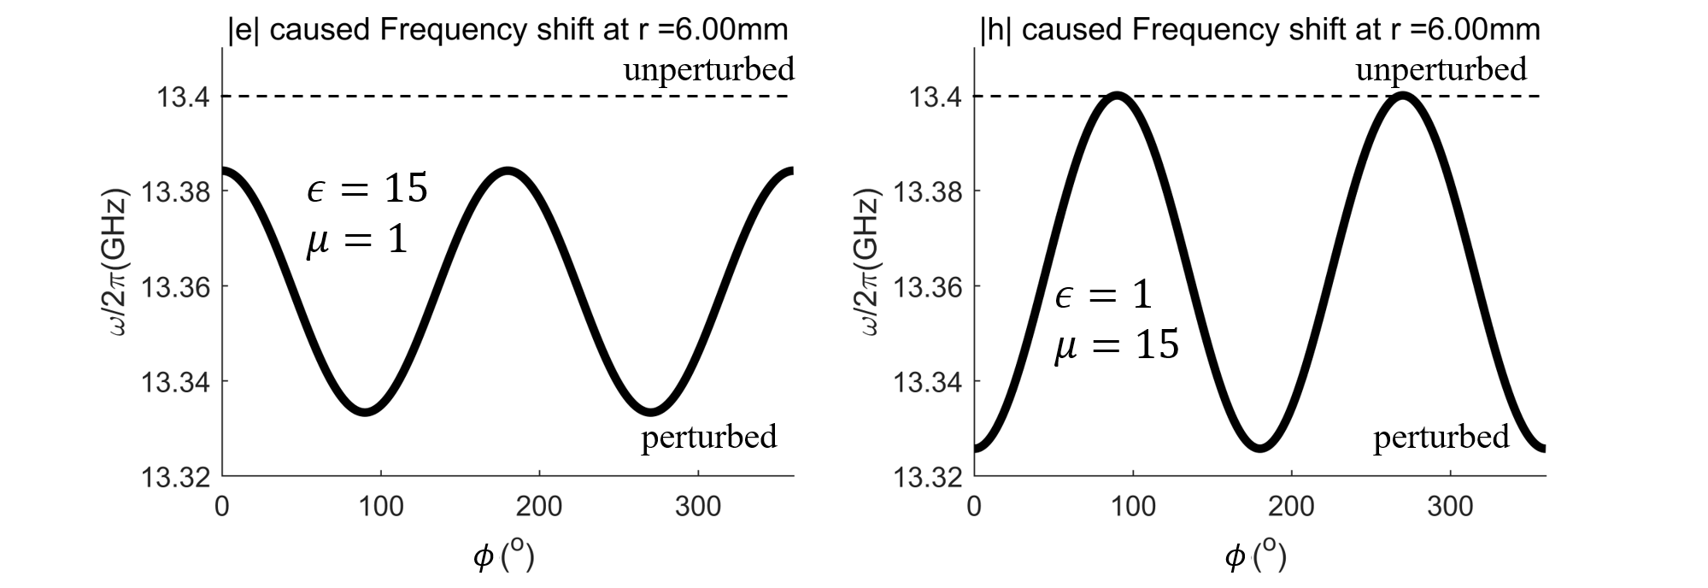
Calculations

Slide 5
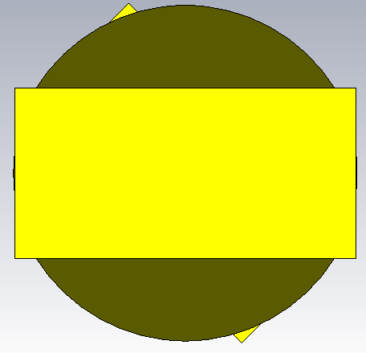
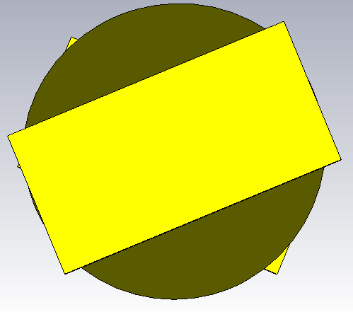
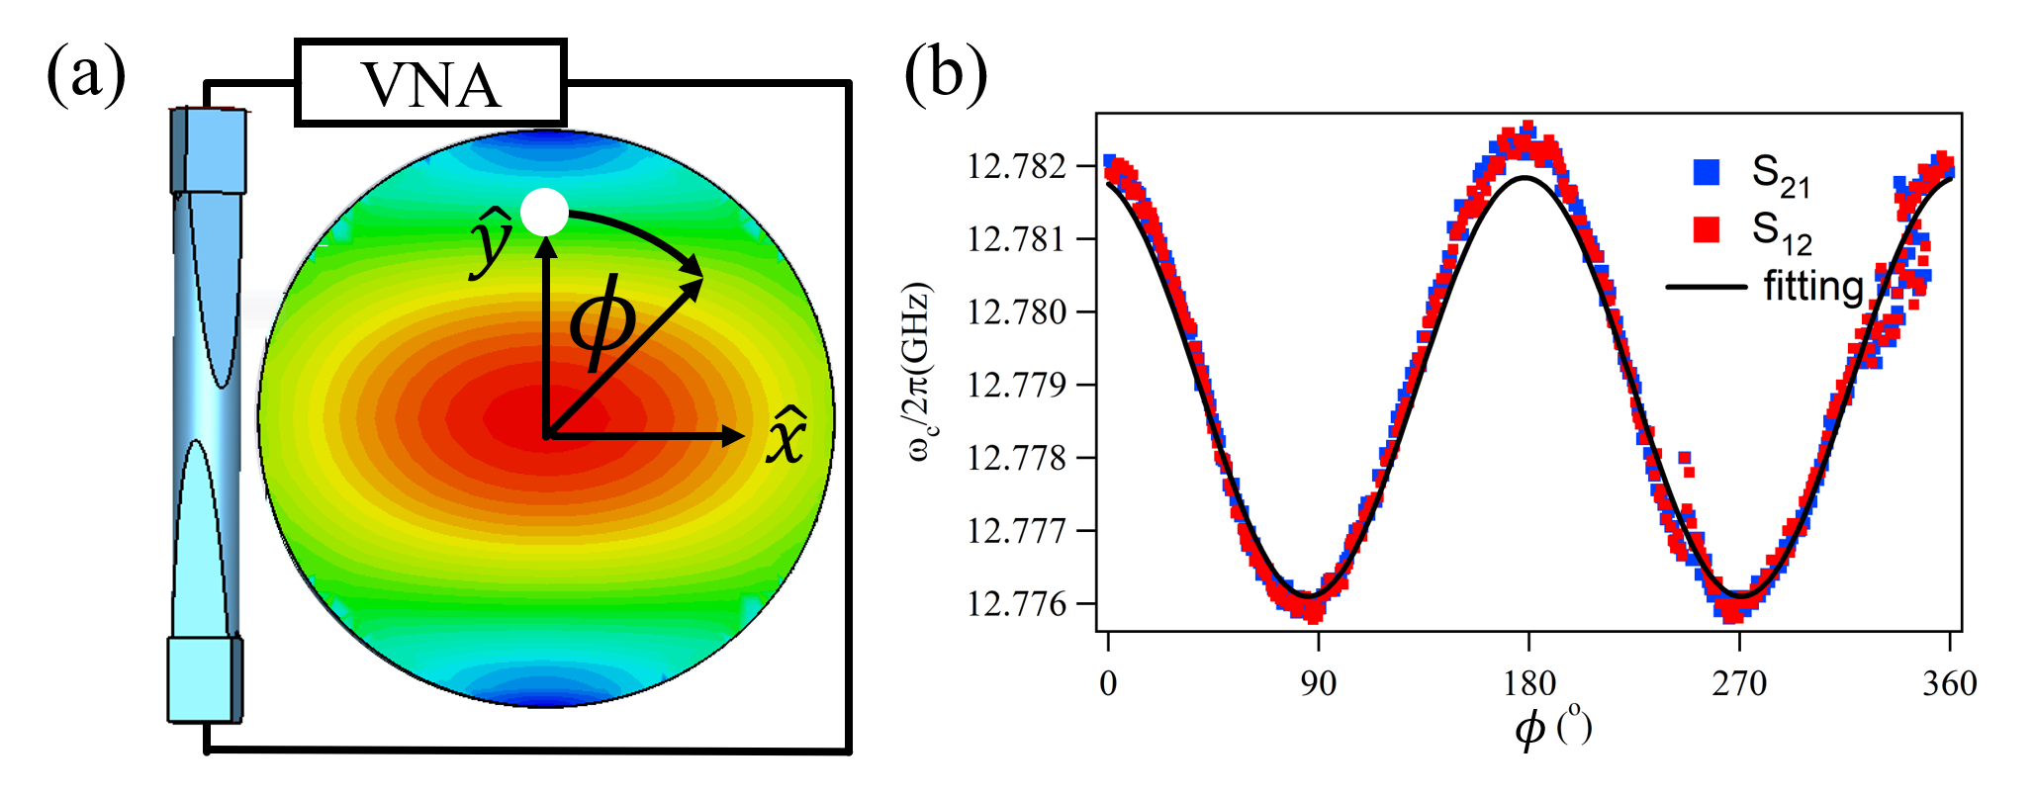

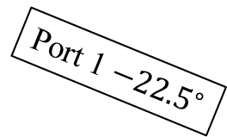

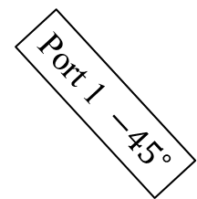



Experiment
Port 2 ${22.5}^{∘}$
$$\hat{x}$$
$${22.5}^{∘}$$
Port 2 $0^{∘}$
$$\hat{x}$$
Port 1 $−{22.5}^{∘}$
Port 1 ${−45}^{∘}$
Previous Front View
Current Front View

Slide 6
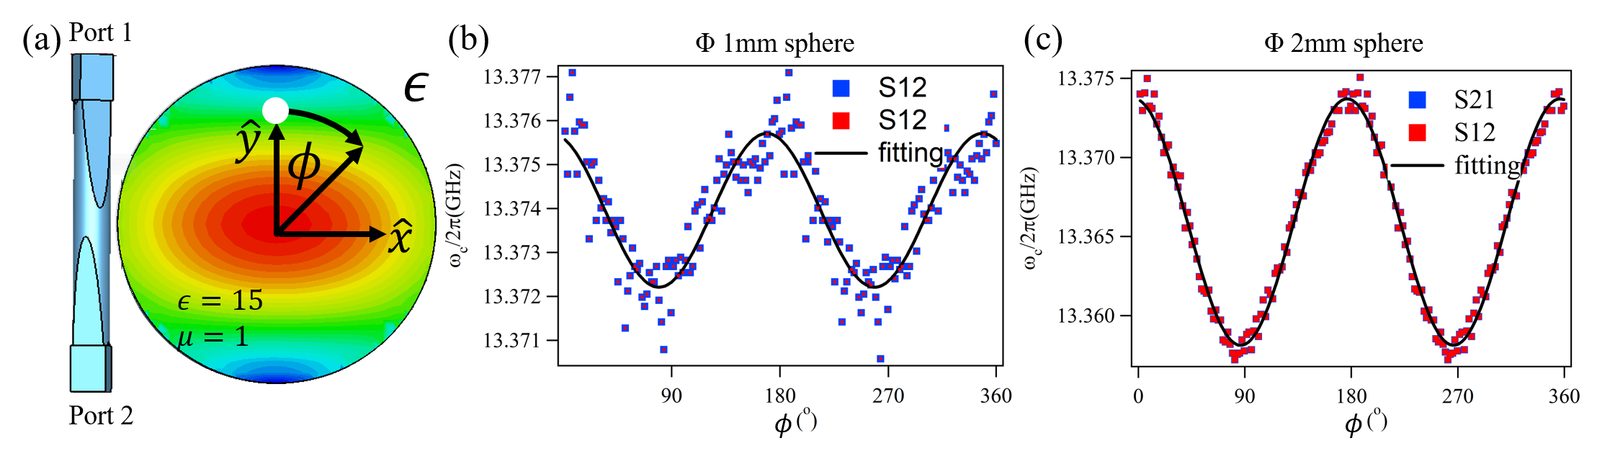
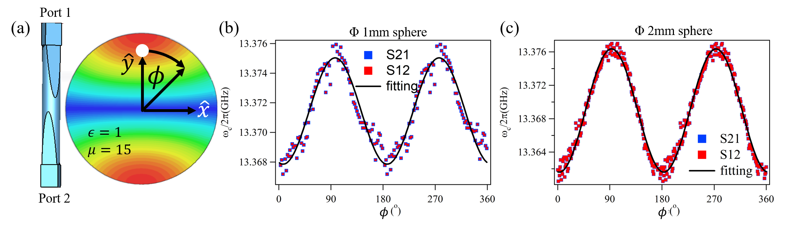
Simulations —— 1D waveguide cavity

Slide 7
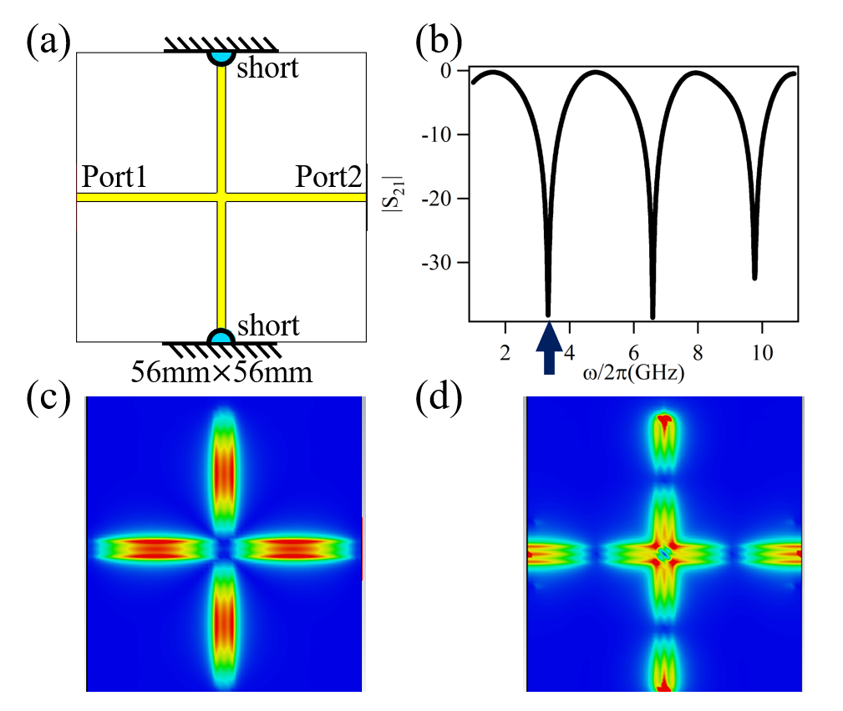
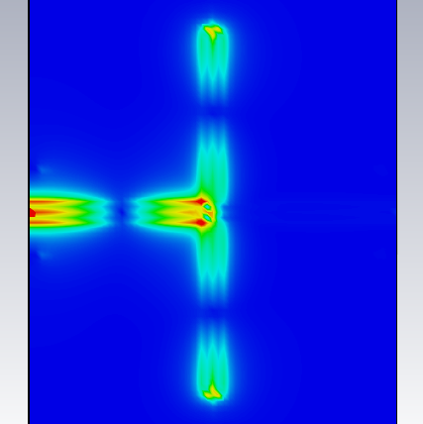
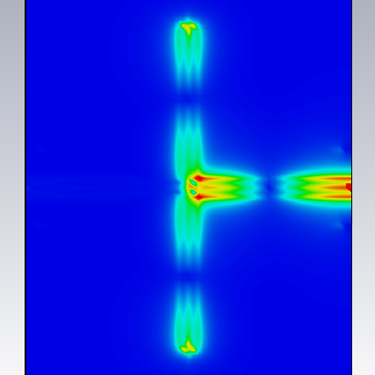
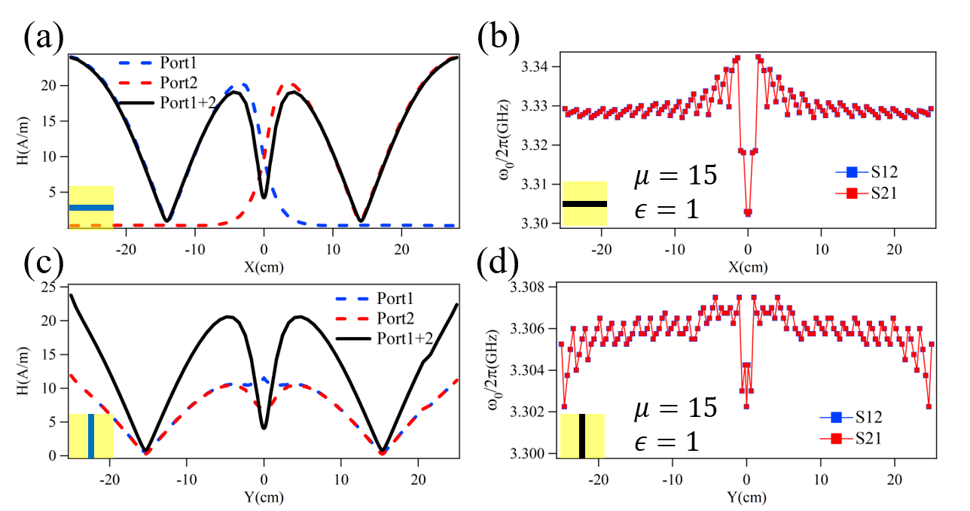
Simulations —— planar cross cavity
Port 1
Port 2
Port 1+2

Slide 8
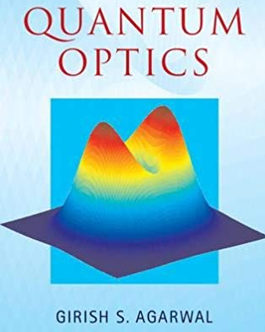
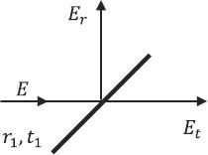
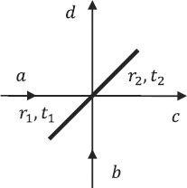

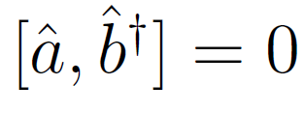
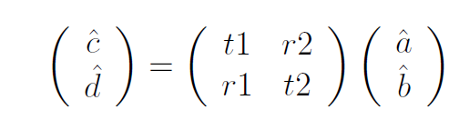

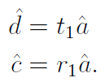
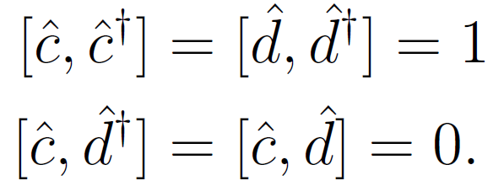









Possible explanation (need further study)
Citation:
$$\hat{d}$$
Classical
$$\hat{d}$$
Quantum
$$\hat{a}$$
$$\hat{a}$$
$$\hat{c}$$
$$E_{i}$$
$$\hat{c}$$
$$\hat{b}$$
In quantum theory vacuum fields are always present. Hence even if no field is sent from the other port of the beam splitter, the vacuum field enters from this port.
The commutation relation we have:
This do not satisfy the following:

Slide 9
Next step on wave physics:
Further study on vacuum field.
Derive the coupling using LLG equation and Maxwell equation.
DRDC project (This week)
Dielectric imaging using SSR sensor

